Slide 1
Fashion & Environment
2021 - repairwhatyouwear.com

Slide 2
What we wear is part of who we are.
We show our choices, character, identity, individuality or our style as part of a group.

Slide 3
But how much do you really know about your clothes?
Do you ever look at the label inside the garment?
What is it made of?
Where is it made?
Why should you care?

Slide 4
Fashion is responsible for 10% of global carbon emissions.
More than all flights and maritime travel combined.
And set to increase by another 50% by 2030.

Slide 5
Fashion production is responsible for 17-20% of global water pollution.

Slide 6
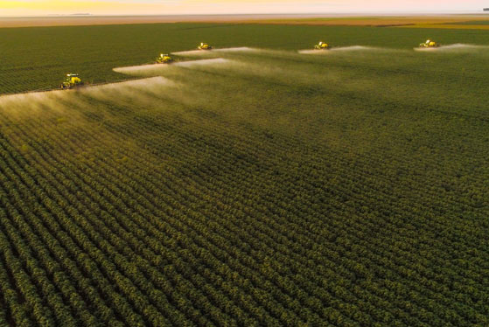
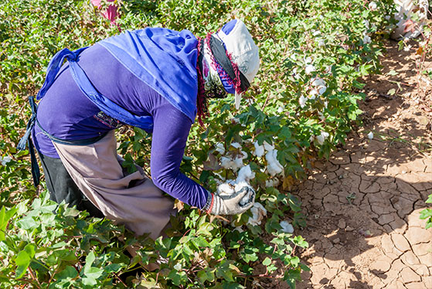
Cotton production uses 16% of global pesticides , whether its large or small producers.
73% of the land growing cotton is irrigated and often in communities where water is a scarce resource.
Cotton

Slide 7
Cellulosic fibres
Cellulosic fabrics, like viscose, acetate, modal are 8% of fashion fabric fibres but last year 150 million trees per annum were felled. Many trees are now from indigenous and protected forests.
So we chop the trees that absorb the carbon to wear the clothes that create the carbon?

Slide 8
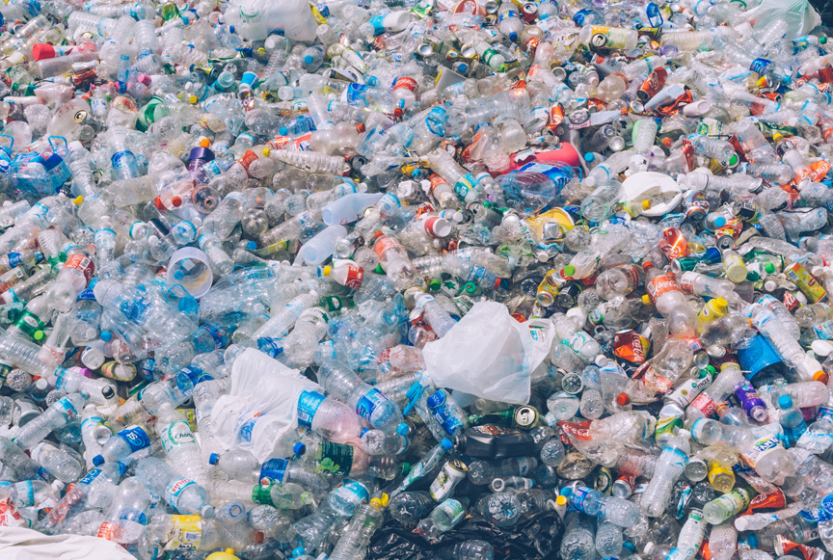
Polyester
51% of our clothes contain polyester - which is plastic! Hard wearing, versatile, cheaper to manufacture and useful. It doesn’t biodegrade and can’t be recycled (at the moment).
What do plastic bottles and sports clothes have in common?
Most bottles and polyester clothing are PET plastic!

Slide 9
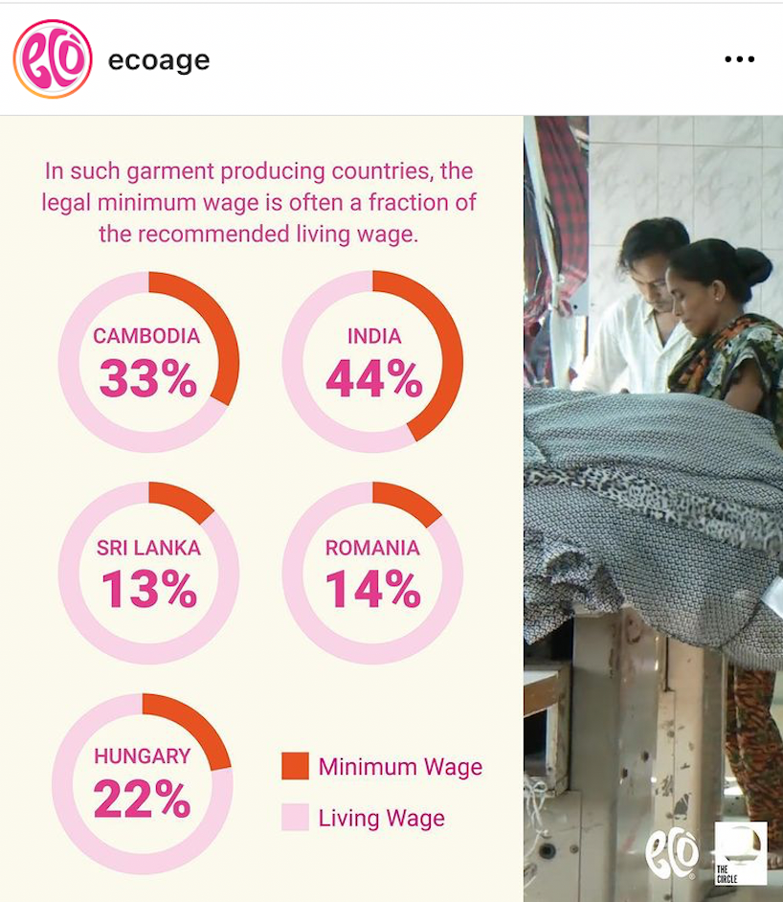
Wages for workers
Fast fashion is the growth area where prices are kept low through a combination of low quality materials and poor working conditions for those in the industry.
Workers are not earning less because it is cheaper to live in their country. They are not even earning 50% of a living wage, as low as 13% of their local living wage.
Ecoage have great articles on fashion and the environment.

Slide 10
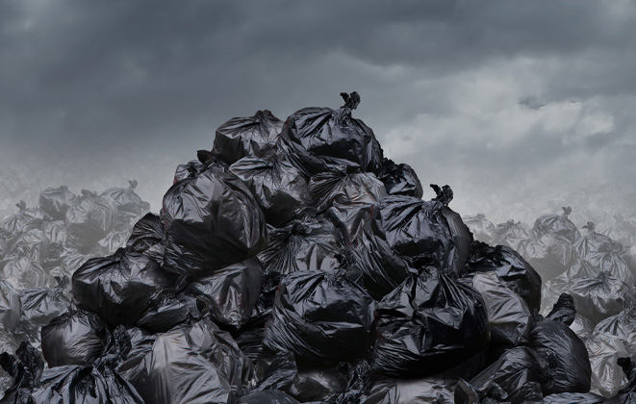
Internet returns
Internet orders have a much higher rate of returned product, estimated at 30-40%.
As much as 50% of the total fast fashion returned product is not put back into stock - either burned or put in landfill as this is the cheapest way of dealing with it.
This means clothes are manufactured, never worn and then pollute again.

Slide 11
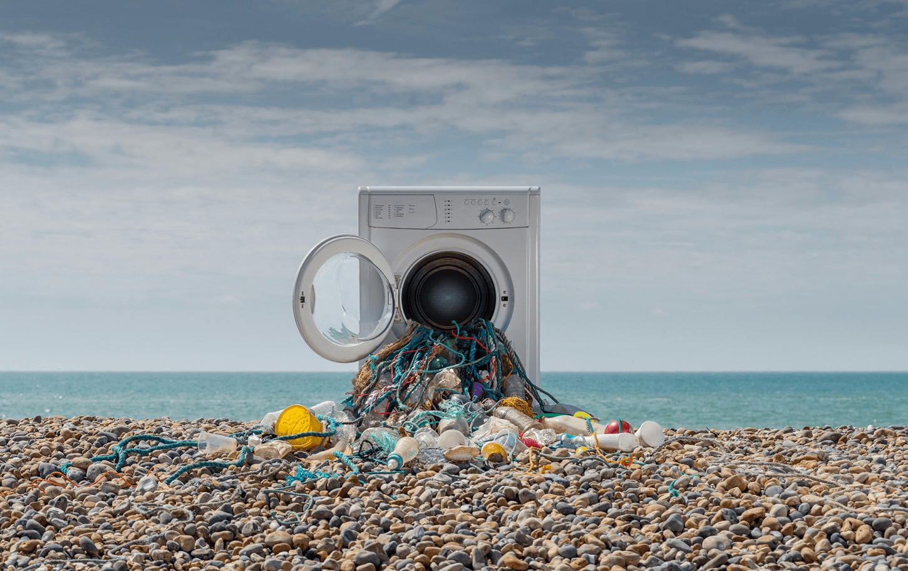
Microfibre pollution
In a recent study, 98% of water samples taken from under the Arctic Ice and in the Polar region contained Micro plastics, 92% of which were fibres and 75% of which were polyester, the same width and colour as used in clothing.
An estimated 700,000 microfibres enter the water system in a machine wash cycle of mixed clothing.
Photo Credit: Alex Bamford & Lou McCurdy

Slide 12
Recycling truths
Currently, the majority of clothes you put in the clothing bank are sorted to be resold in other countries, burned or binned.
Globally, 9% of fashion is recycled into other materials like insulation, wadding, cloths.
It is estimated that 80% of discarded clothing ends up in landfill, if not in the country where it was originally bought, then in another country where it was exported for resale.

Slide 13
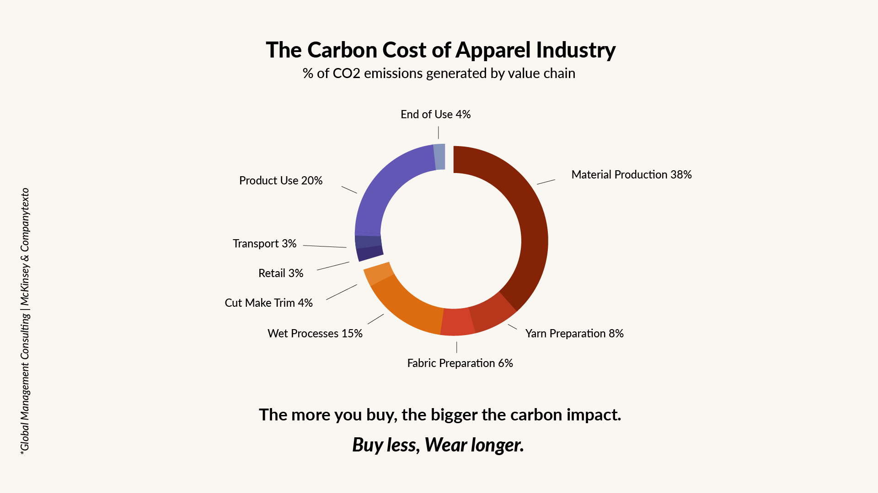
Over 70% of carbon emissions derive from the MAKING of your clothes.

Slide 14
Positive Action - Your Project Brief:
Design and repurpose a used 100% cotton T shirt or shirt
To reflect your understanding and response to:
Fashion &
Environment

Slide 15
Learn about fibres, fabric, dyeing and hand skills to create something new!
Explore Cotton
Experiment with Dyes
Understand polyester
Play with polyester manipulation and design it into your garment
Learn basic hand skills and use these creatively in your final product
Design for a specific event and audience
What changes can individuals and industry make to reduce Fashion’s impact on the planet?

Slide 16
Get going!
Your actions can make a difference.

